Slide 1
Lecture 23
DATA 8
Fall 2021
Center and Spread

Slide 2
Center and Spread

Slide 3
Questions
How can we quantify natural concepts like “center” and “variability”?
Why do many of the empirical distributions that we generate come out bell shaped?
How is sample size related to the accuracy of an estimate?

Slide 4
Average

Slide 5
The Average (or Mean)
Data: 2, 3, 3, 9 Average = (2+3+3+9)/4 = 4.25
Need not be a value in the collection
Need not be an integer even if the data are integers
Somewhere between min and max, but not necessarily halfway in between
Same units as the data
Smoothing operator: collect all the contributions in one big pot, then split evenly
(Demo)

Slide 6
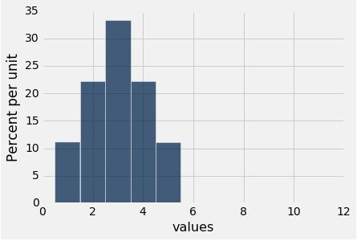
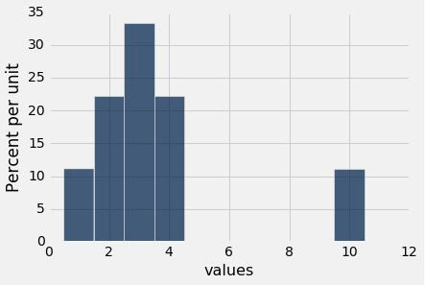
Discussion Question
Are the medians of these two distributions the same or different? Are the means the same or different? If you say “different,” then say which one is bigger.

Slide 7
Comparing Mean and Median
Mean: Balance point of the histogram
Median: Half-way point of data; half the area of histogram is on either side of median
If the distribution is symmetric about a value, then that value is both the average and the median.
If the histogram is skewed, then the mean is pulled away from the median in the direction of the tail.

Slide 8
Standard Deviation

Slide 9
Defining Variability
Plan A: “biggest value - smallest value”
Doesn’t tell us much about the shape of the distribution
Plan B:
Measure variability around the mean
Need to figure out a way to quantify this
(Demo)

Slide 10
How Far from the Average?
Standard deviation (SD) measures roughly how far the data are from their average
SD = root mean square of deviations from average 5 4 3 2 1
SD has the same units as the data

Slide 11
Why Use the SD?
There are two main reasons.
The first reason:
No matter what the shape of the distribution,
the bulk of the data are in the range “average ± a few SDs”
The second reason:
Coming up next time.

Slide 12
Chebyshev's Inequality

Slide 13
How Big are Most of the Values?
No matter what the shape of the distribution,
the bulk of the data are in the range “average ± a few SDs”
Chebyshev’s Inequality
No matter what the shape of the distribution,
the proportion of values in the range “average ± z SDs” is
at least 1 - 1/z²

Slide 14
Chebyshev’s Bounds
Range | Proportion
average ± 2 SDs | at least 1 - 1/4 (75%)
average ± 3 SDs | at least 1 - 1/9 (88.888…%)
average ± 4 SDs | at least 1 - 1/16 (93.75%)
average ± 5 SDs | at least 1 - 1/25 (96%)
No matter what the distribution looks like
(Demo)

Slide 15
Standard Units

Slide 16
Standard Units
How many SDs above average?
z = (value - average)/SD
Negative z:
Positive z:
z = 0:
value below average value above average value equal to average
When values are in standard units: average = 0, SD = 1
Chebyshev: At least 96% of the values of z are between
-5 and 5
(Demo)

Slide 17
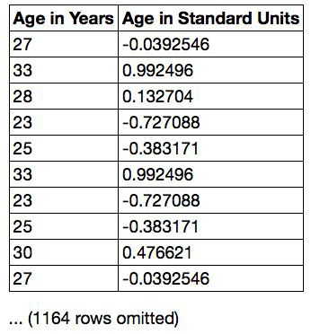
Discussion Question
Find whole numbers that are close to:
the average age
the SD of the ages (Demo)

Slide 18
The SD and the Histogram
Usually, it's not easy to estimate the SD by looking at a histogram.
But if the histogram has a bell shape, then you can.

Slide 19
The SD and Bell-Shaped Curves
If a histogram is bell-shaped, then
the average is at the center
the SD is the distance between the average and the points of inflection on either side
(Demo)

Slide 20
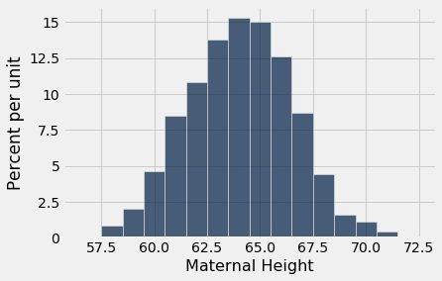
Point of Inflection

Slide 21
The Normal Distribution

Slide 22
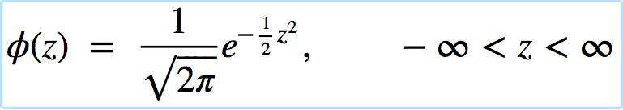
The Standard Normal Curve
A beautiful formula that we won’t use at all:

Slide 23
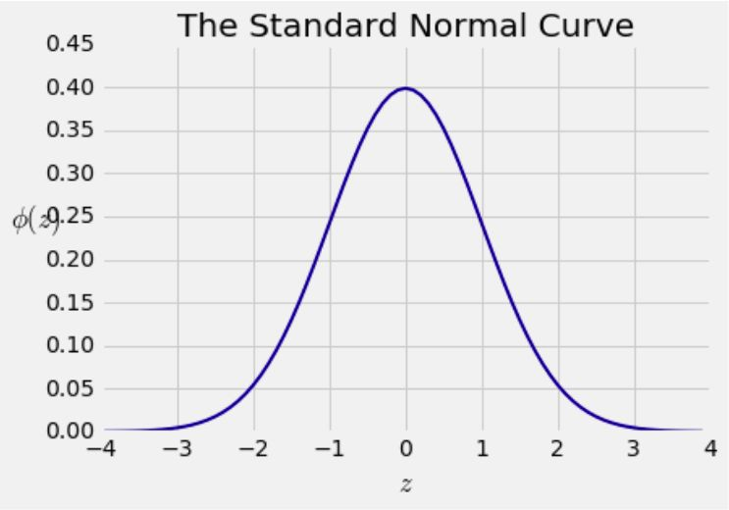
Bell Curve

Slide 24
Normal Proportions

Slide 25
How Big are Most of the Values?
No matter what the shape of the distribution,
the bulk of the data are in the range “average ± a few SDs”
If a histogram is bell-shaped, then
Almost all of the data are in the range “average ± 3 SDs”

Slide 26
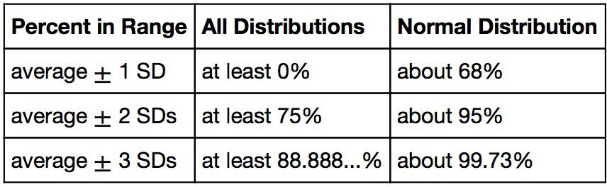
Bounds and Normal Approximations

Slide 27
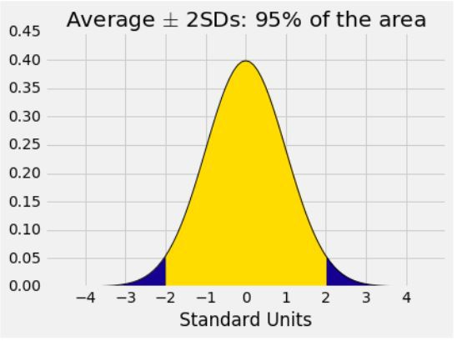
A “Central” Area

Slide 28
Central Limit Theorem

Slide 29
Sample Averages
The Central Limit Theorem describes how the normal distribution (a bell-shaped curve) is connected to random sample averages.
We care about sample averages because they estimate population averages.

Slide 30
Central Limit Theorem
If the sample is
large, and
drawn at random with replacement,
Then, regardless of the distribution of the population,
the probability distribution of the sample sum (or the sample average) is roughly normal
(Demo)

